Slide 1
Academic Writing
Technical Report Writing
Lectures 4 & 5
20th & 22nd August 2019

Slide 2
Objective: To understand the nature of academic texts
Characteristics of an Academic Text
The Anatomy of an Academic Article
Genres of Academic Texts
Rhetorical Modes used in Academic Texts

Slide 3
1. Characteristics of an Academic Text >>
Formal
Objective
Precise

Slide 4
Academic texts avoid casual or conversational language and to do this they make use of formal vocabulary.
Examples: (a) the use of ‘somewhat’ c.f. ‘a bit’;
(b) avoiding contractions like didn’t and using ‘did not’ instead;
(c) avoiding emotional tones such as ‘wonderful or ‘terrible’ and using moderate phrases such as ‘helpful’ or ‘problematic’;
(d) avoiding the use of absolute positives and negative such as ‘wrong’ and opting instead for words like ‘less convincing’

Slide 5
Use of Objective language:
Objective language focuses on the plain facts about a person or object.
In contrast, subjective language focuses on the attitudes, values, thoughts, feelings, or beliefs of the person who is doing the writing or speaking.

Slide 6
Examples:
Acetaminophen is sold over the counter as a pain medication.
Acetaminophen is the most dangerous over-the-counter pain medication.
A 2013 episode of This American Life presented a number of studies that verified that acetaminophen has killed more people than any other over-the-counter pain medication.
In the This American Life episode on acetaminophen, one segment described the tragic death of a five-month-old baby and thus should convince listeners that the Federal Drug Administration (FDA) must take immediate action.

Slide 7
1.
i. In an Irish study, participants who exercised showed measurable improvement of their memory while participants who did not exercise showed no improvement.
ii. All students should exercise, not just because exercise is fun, but also because it is good for the brain.
2.
i. An analysis of the results of case studies of six Chicago agencies shows that employers use information from candidates' job histories in order to make hiring decisions.
ii. Job seekers can be unfairly discriminated against based on their past employment history.

Slide 8
Precise Language:
Academic writing makes committed efforts to be precise when presenting information.
Imprecise or ambiguous terms such as “a lot of people” are generally avoided in favour of stating exact figures such as “50 million people”.
The use of qualifications:
Example 1: Chinese are Buddhist. They go to the temple five times a year, live simple lives, and give money to charity.
Example 2: Many Chinese are Buddhists. Practising Buddhists go to the temple about five times a year, generally try to live simple lives, and give money to charity when they can.

Slide 9
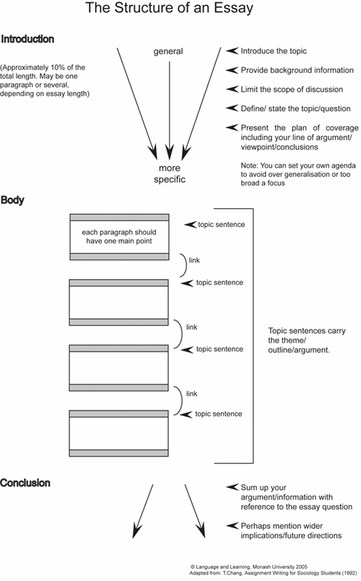
2. Anatomy of an Academic Text >>
The Classic Essay
Source: English Skills One (2018)

Slide 10
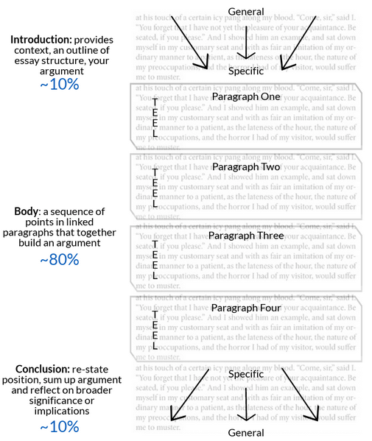
2. Anatomy of an Academic Text >>
The Classic Essay
Source: Monash University (n.d.)

Slide 11
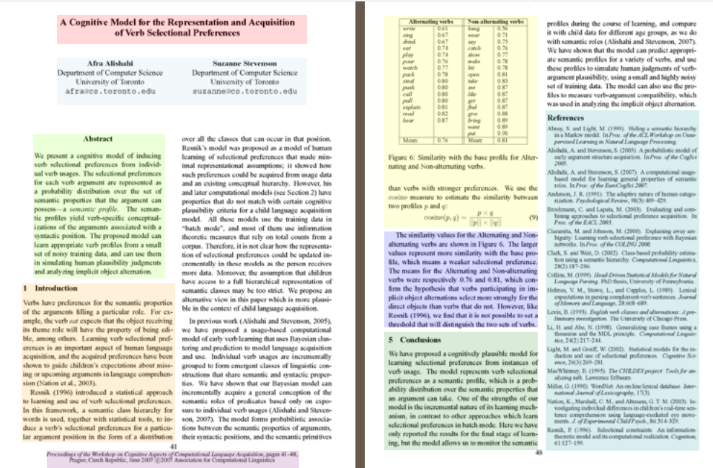
2. Anatomy of an Academic Text >>
The Academic Article
Source: NCSU Libraries (2009)

Slide 12
2. Anatomy of an Academic Text >>
Parts of an Academic Article
Title
Authors
Financial equipment Support
Abstract
Introduction
Literature review
Main body
Conclusion
Acknowledgements
References
Source: NCSU Libraries (2009)

Slide 13
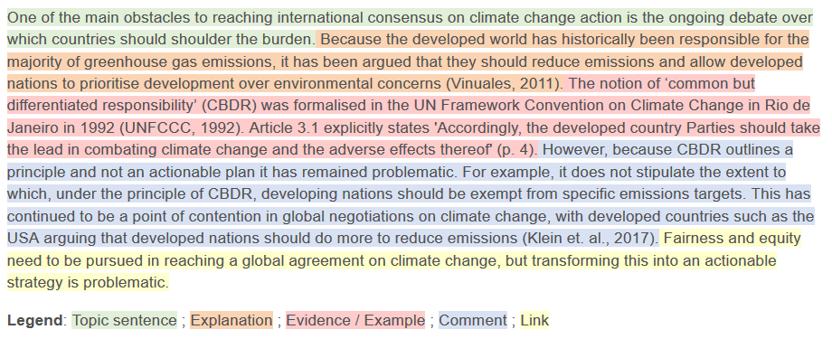
2. Anatomy of an Academic Text >>
Parts of an Academic Article
Title
Authors
Financial equipment Support
Abstract
Introduction
Literature review
Main body
Conclusion
References
Figure: Using TEEcL when Structuring a Paragraph

Slide 14
3. Genres of Academic Texts >>
Essays
Research paper/article
Proposal
Review of literature
Dissertation/Thesis

Slide 15
4. Rhetorical Modes used in Academic Texts >>
Descriptive
Analytical
Critical
Persuasive

Slide 16
References >>
ASK Academic Skills (n.d.) 'The Power of the Paragraph', Available online: https://vimeo.com/44666462 [Accessed on 5th June 2019]
Best Custom Writing (2018) 'The 4 Types of Academic Writing' Available online:https://www.bestcustomwriting.com/blog/types-of-academic-writing [Accessed on 5th June 2019]
Branson, R. D. (2004) ‘The Anatomy of an Academic Article’ in Respiratory Care, Vol. 49 (October), No. 10. Available online: http://www.rcjournal.com/contents/10.04/10.04.1222.pdf [Accessed on 5th June 2019]
English Skills One (2018) 'Unit II - Genres and Types of Academic Writing' Available online: https://www.englishskillsone.com/units-1-iv/c/0/i/21114864/unit-ii-genres-and-types-academic-writing [Accessed on 5th June 2019]
Hartley, J. (2008) Academic Writing and Publishing: A practical handbook. New York: Routledge.
Lund University (2011) 'Academic Writing in English', Available online: https://awelu.srv.lu.se/sources-and-referencing/writing-acknowledgements/ [Accessed on 5th June 2019]
Medawar, P (1964) ‘Is the Scientific Paper a Fraud?’ Listener. 1963;70:377–378. Available Online: http://www.weizmann.ac.il/mcb/UriAlon/sites/mcb.UriAlon/files/uploads/medawar.pdf [Accessed on 5th June 2019]
Monash University (n.d.) 'Research and writing for assignments'. Available online: https://www.monash.edu/rlo/research-writing-assignments/writing/clear-communication/writing-clearly-concisely-and-precisely [Accessed on 6th June 2019]
NCSU Libraries (2009) 'Anatomy of a Scholarly Article' Available online: https://www.lib.ncsu.edu/tutorials/scholarly-articles/ [Accessed on 5th June 2019]
UEFAP (n.d.) 'Features of Academic Writing'. Available online: http://www.uefap.com/writing/feature/precise.htm [Accessed on 6th June 2019]
University of Sydney (2019) 'Writing' Available online: https://sydney.edu.au/students/writing.html [Accessed on 5th June 2019]

